Slide 1

Cloud Computing With AWS
Presented By:
Name -
Branch -
Roll No. -

Slide 2
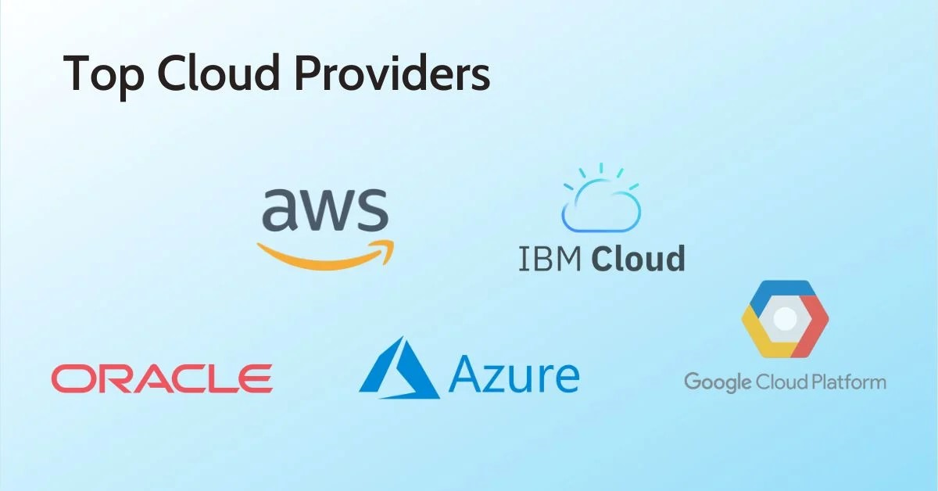

What is cloud computing?
Cloud computing is the on-demand delivery of IT resources over the Internet with pay-as-you-go pricing. Instead of buying, owning, and maintaining physical data centers and servers, you can access technology services, such as computing power, storage, and databases, on an as-needed basis from a cloud provider like AWS(Amazon web services), Microsoft Azure , Google cloud etc.

Slide 3
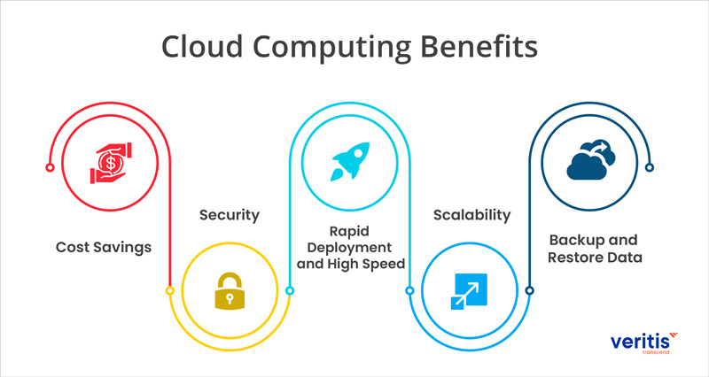
Benefits of cloud computing
Trade capital expense for variable expense.
Benefit from massive economies of scale.
Eliminate guessing on your capacity needs.
Increase speed and agility.
Stop spending money to run and maintain data centers.
Go global in minutes.

Slide 4

What is AWS ?
Amazon Web Services (AWS) is the world’s most comprehensive and broadly adopted cloud, offering over 200 fully featured services from data centers globally. Millions of customers—including the fastest-growing startups, largest enterprises, and leading government agencies—are using AWS to lower costs, become more agile, and innovate faster.

Slide 5
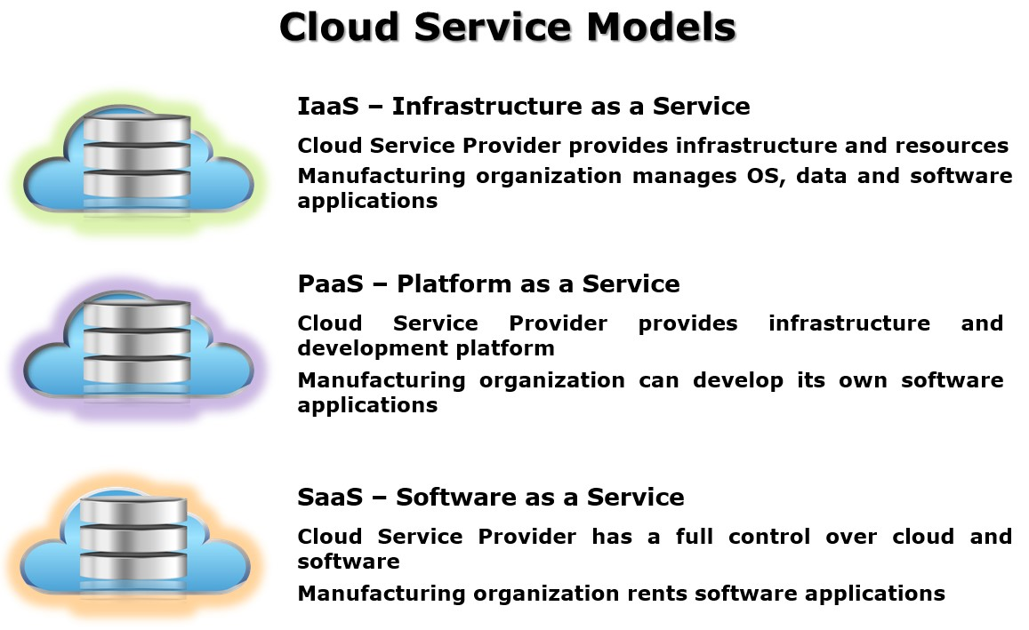
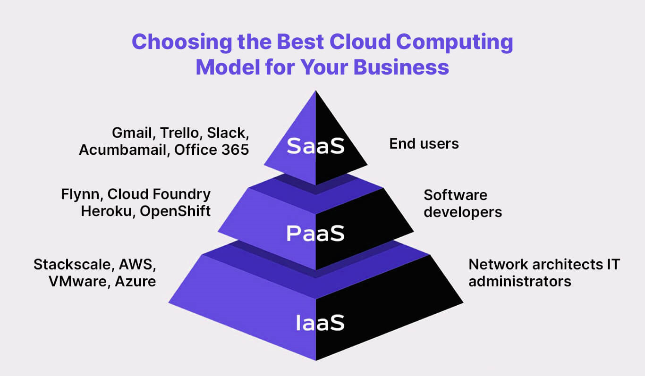
Cloud Computing Models

Slide 6
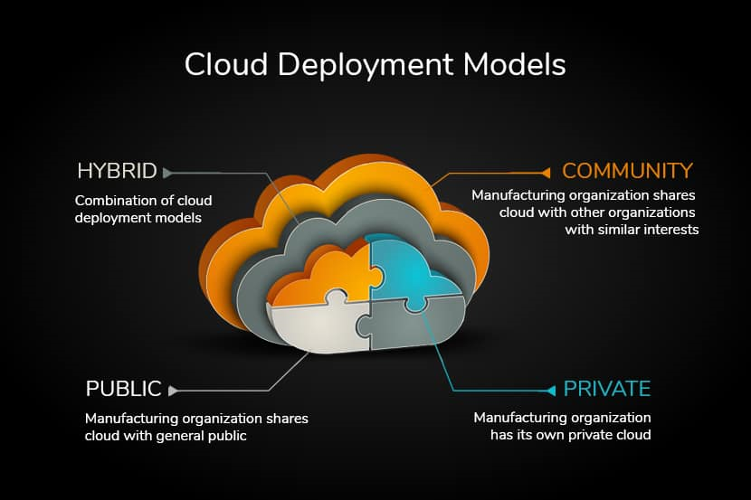
Cloud Deplyment Models

Slide 7
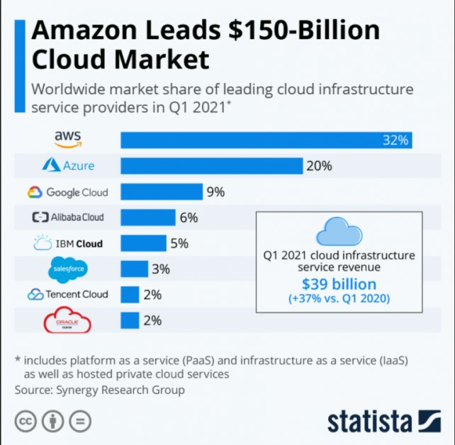
Cloud computing with AWS
Amazon Web Services (AWS) is the world’s most comprehensive and broadly adopted cloud, offering over 200 fully featured services from data centers globally.
Millions of customers—including the fastest-growing startups, largest enterprises, and leading government agencies—are using AWS to lower costs, become more agile, and innovate faster.

Slide 8
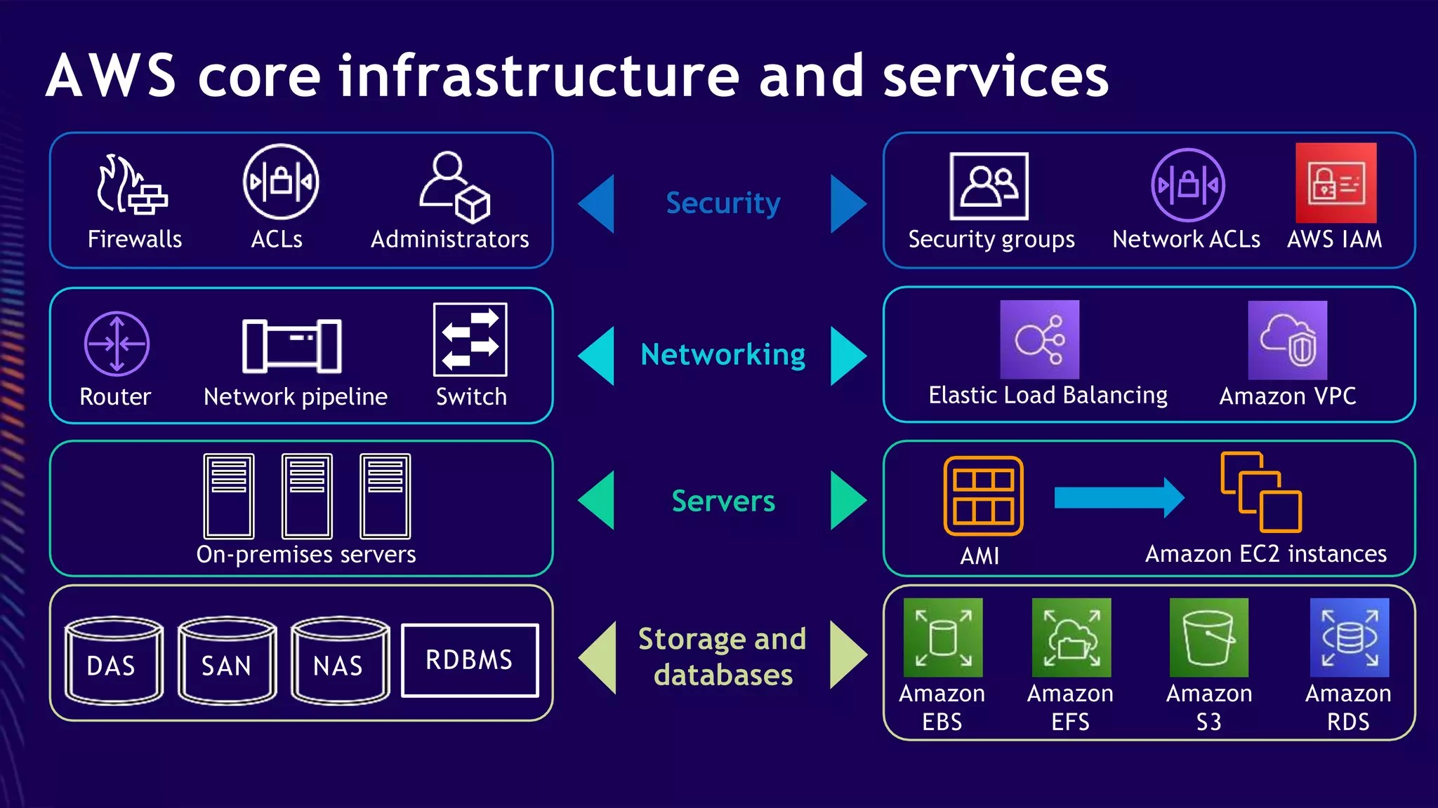
AWS Infrastructure

Slide 9
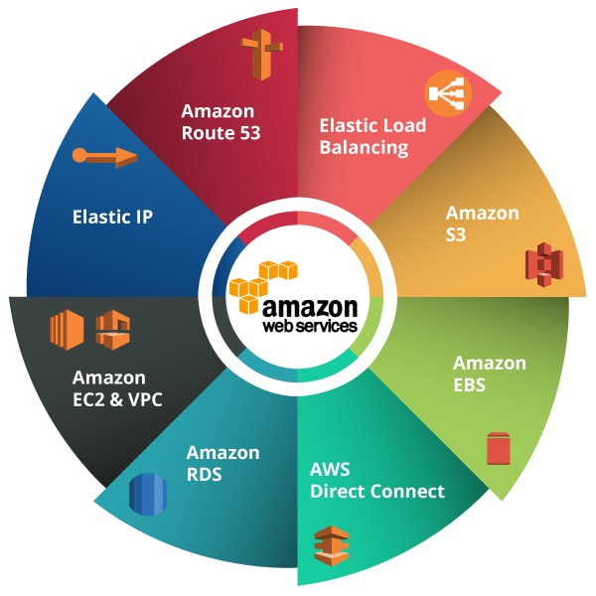
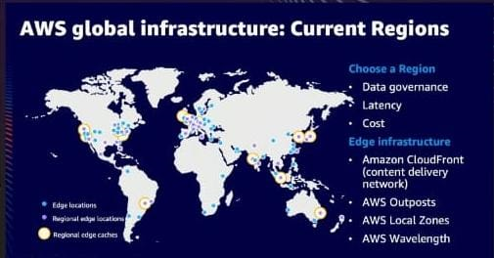
AWS Services
AWS Availability Regions

Slide 10
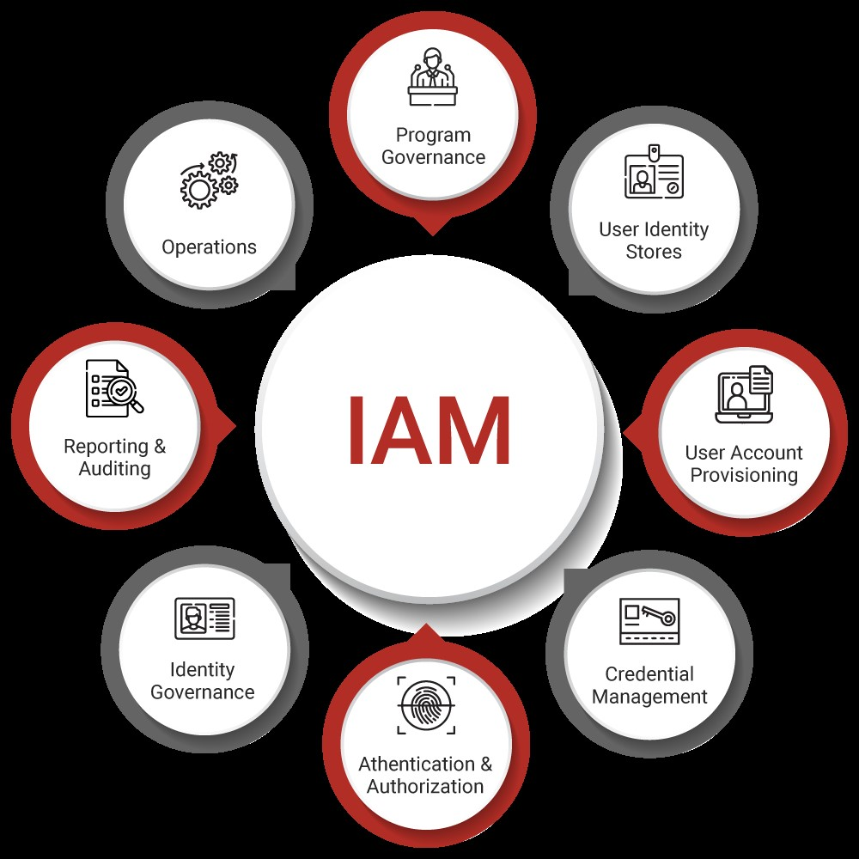
IAM(Internet Access Management)
AWS Identity and Access Management (IAM) is a web service that helps you securely control access to AWS resources. With IAM, you can centrally manage permissions that control which AWS resources users can access. You use IAM to control who is authenticated (signed in) and authorized (has permissions) to use resources.

Slide 11
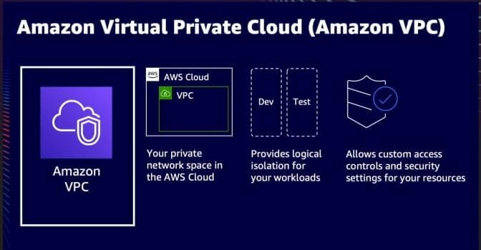
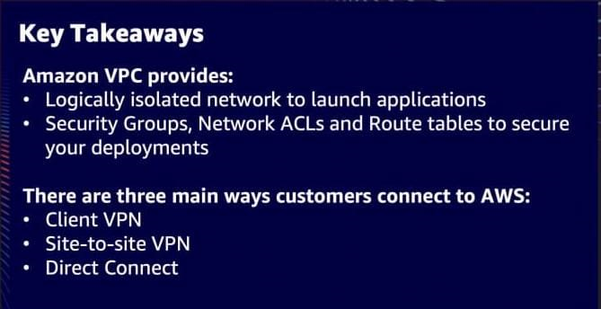

VPC(Virtual Private Cloud)

Slide 12
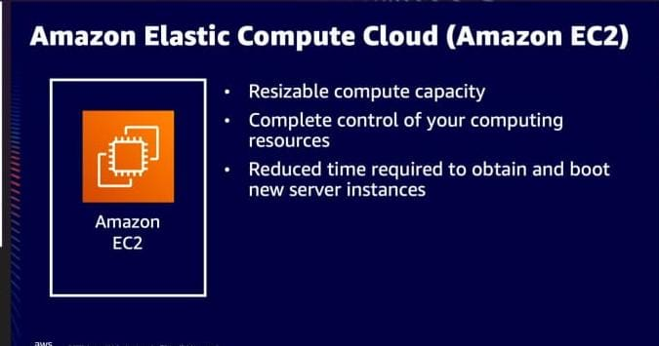
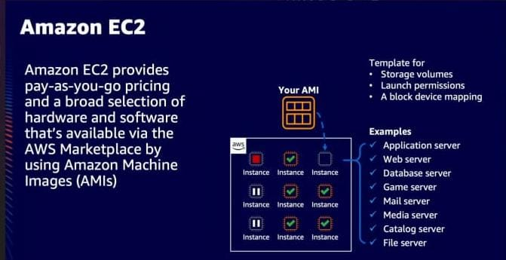
EC2(Elastic Compute Cloud)

Slide 13

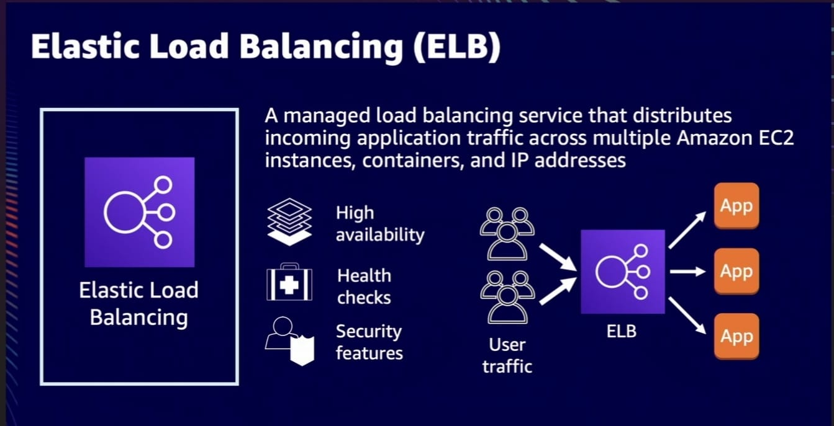
AWS Access and Management Services
1.Elastic Load Balancing (ELB)

Slide 14
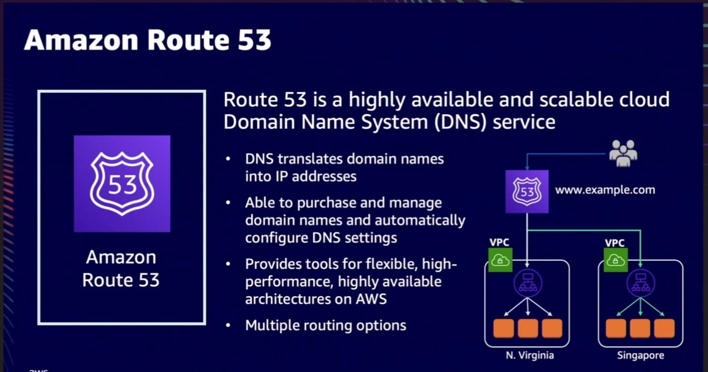
2. Amazon Route 53

Slide 15
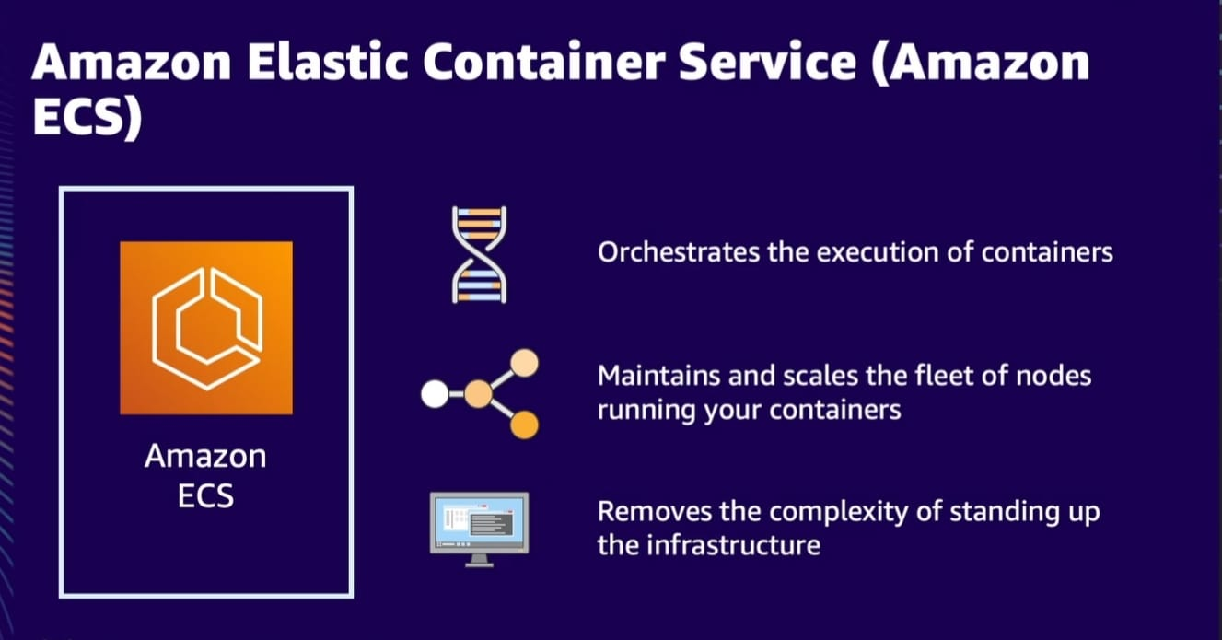
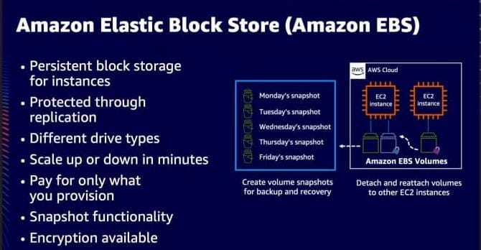
ECS AND EBS

Slide 16
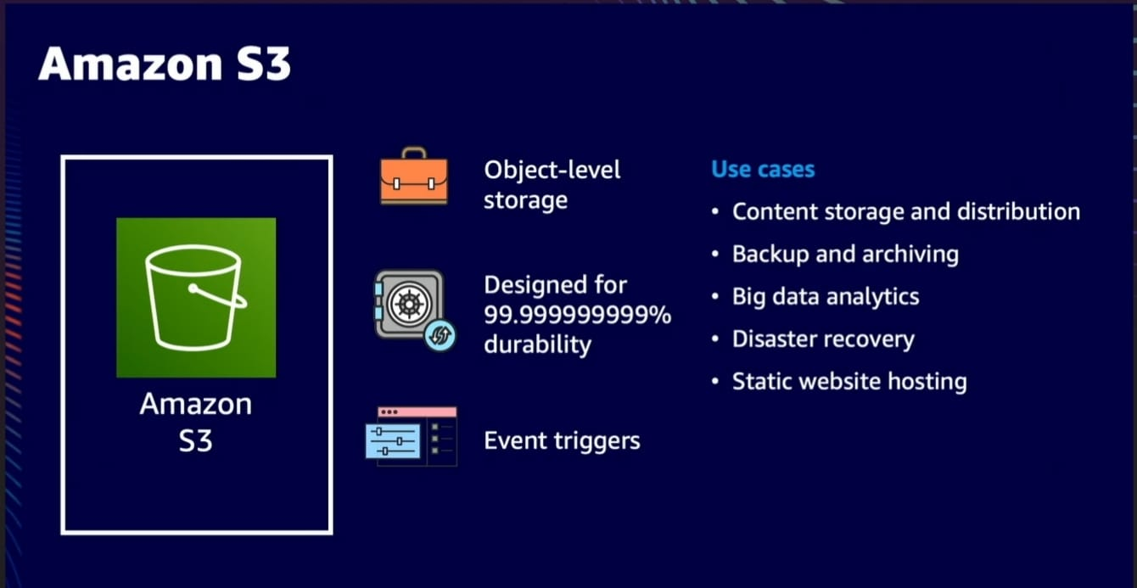
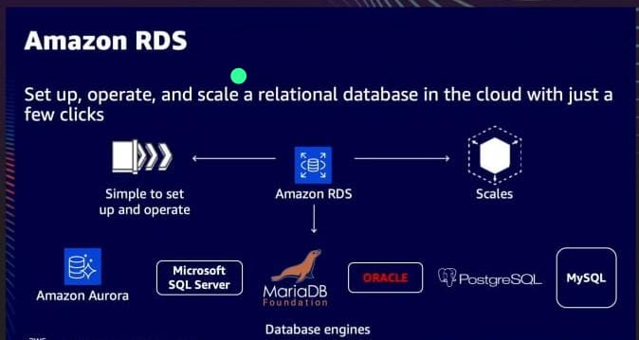
Storage

Slide 17







AWS Application
Marketing
Health , Research & Innovation
Aerospace & Satellite
Education & Training
Energy
Manufacturing
Media and Entertainment
Agriculture

Slide 18

THANK YOU

